Slide 1











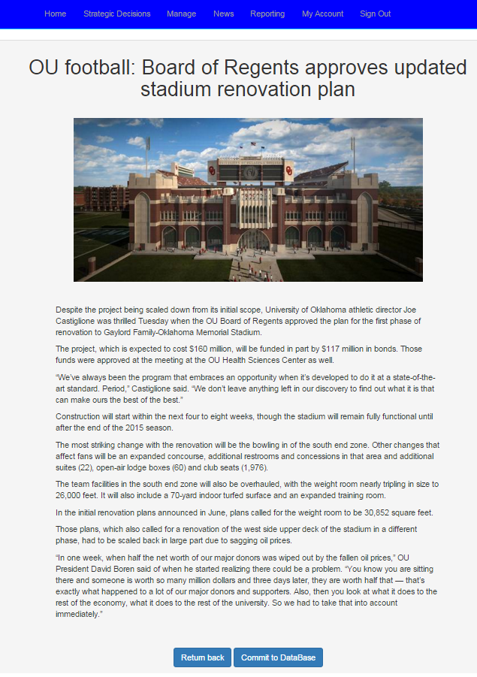
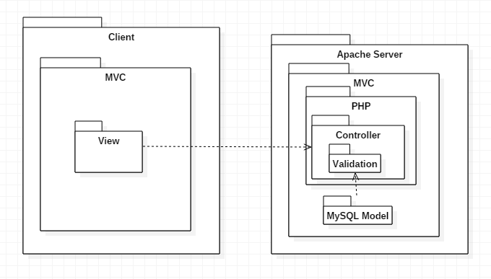
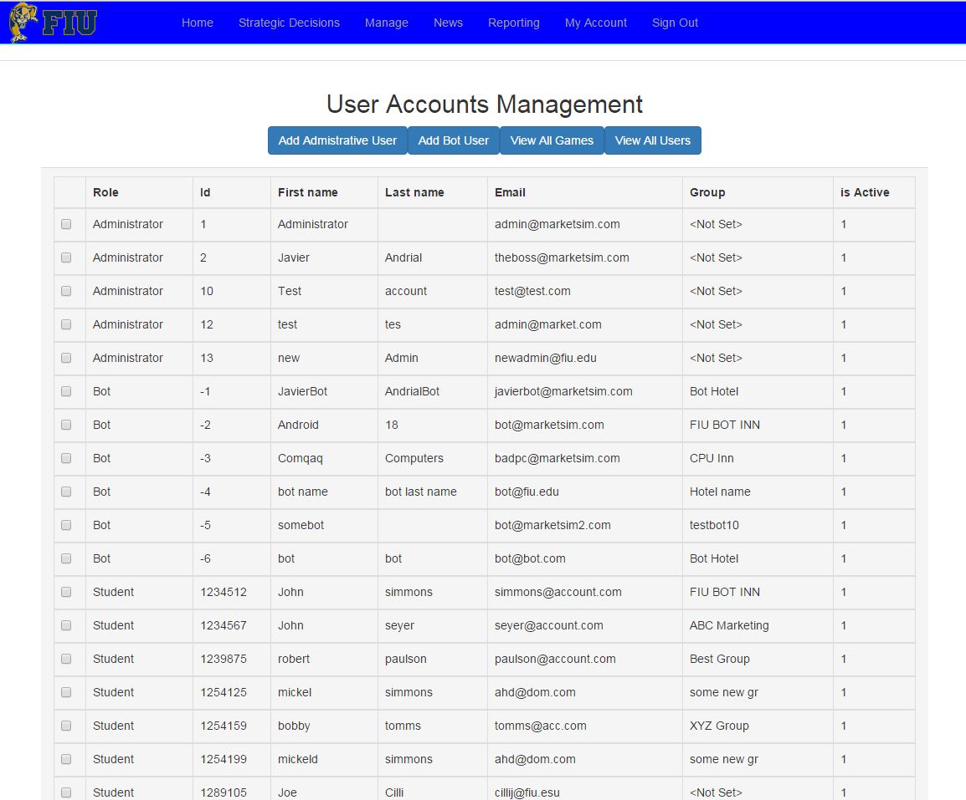
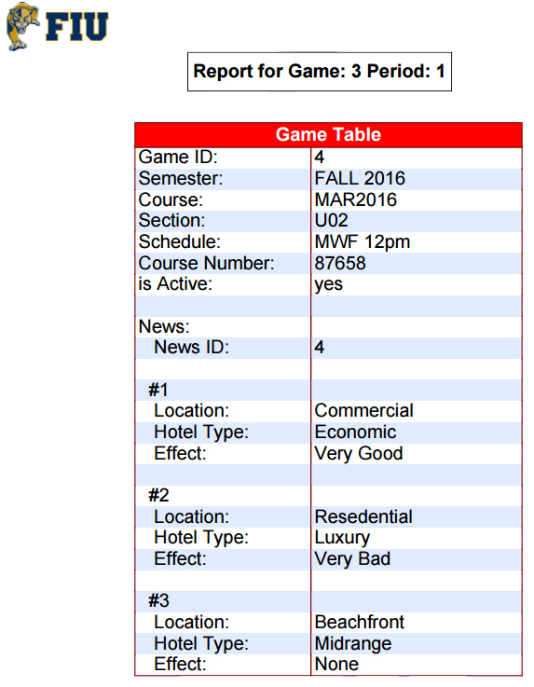
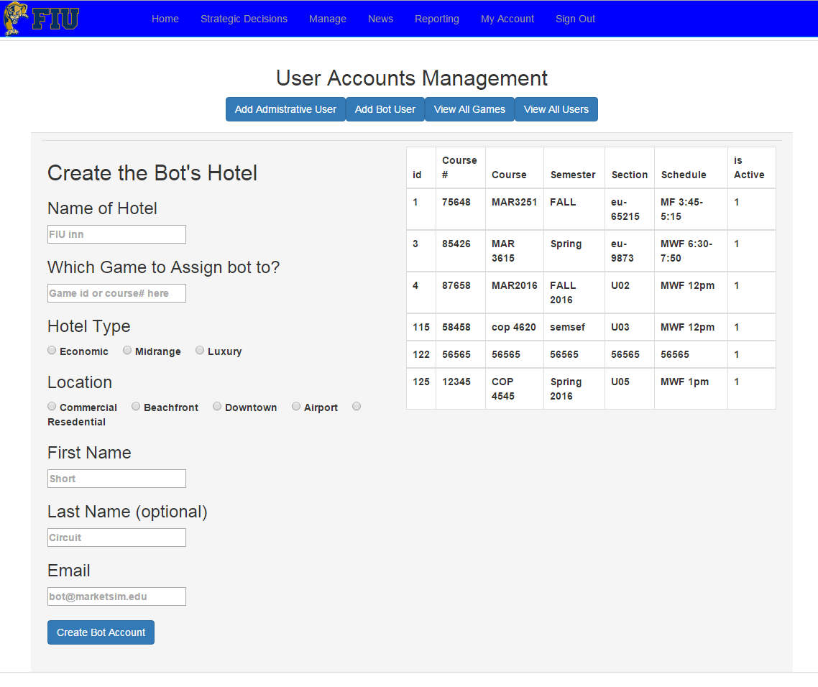
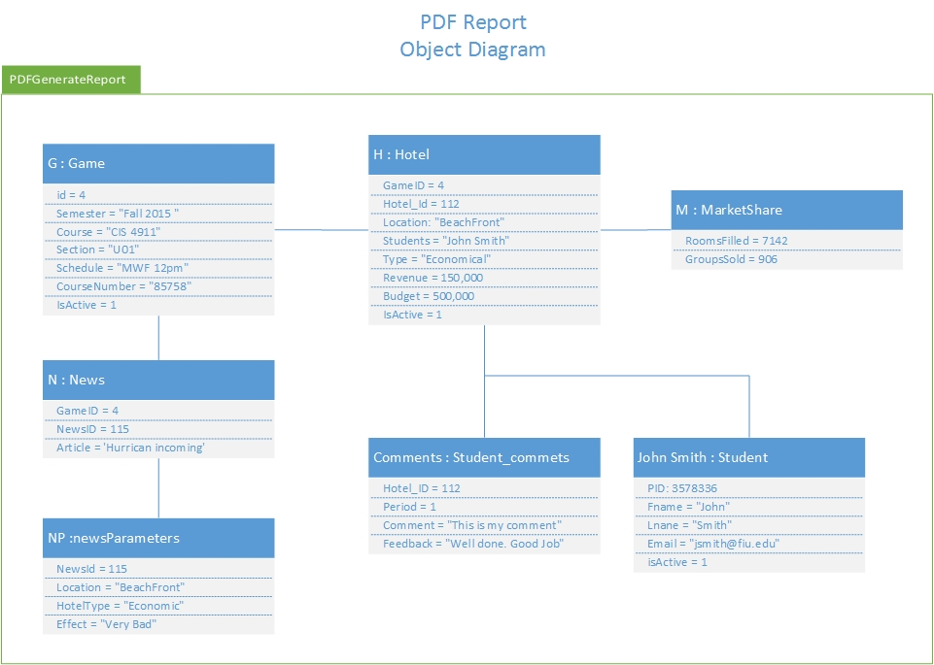
School of Computing & Information Sciences
Senior Project, 2015, Fall
Strategic Marketing Simulator 1.0
Student: Javier Andrial, Florida International University
Mentor: Josiah Bradley, FIU
Instructor: Masoud Sadjadi, Florida International University
Problem
Screenshots
System Design
FIU Marketing department is looking for a competitive market simulator, which can simulate a sudo realistic environment, where students can create and run their own hotels. Students will compete amongst each other for market share, as well as handling external variables, such as hurricanes or a super bowl.
The system design of our System is based upon the Model-View-Controller architecture.
A web browser is used for viewing the Views on the client-side.
Server-side, Controller and Model are constructed using PHP and MySQL encompassed in Apache HTTP service
Current System
The current system in place is a traditional classroom lecture.
The instructor and their students would discuss realistic scenarios and argue how they might playout and how it might affect a business, as well as what can be done to counter rival businesses and environmental variables.
Requirements
The requirements Expressed by the Client are
The application must be composted of Games. A Game must be composted of Hotels and Periods. A Hotel, must be composed of Students.
The application must simulate a competitive market environment between all of the Hotels in a Game.
The Games must have set length cycles called ‘Periods’. At the end of a period, calculations must be performed to evaluate the performance of each Hotel, compared with other hotels in the Game.
Hotels must have set parameters such as Location, Type, and Budget.
Students must enter in their “strategic decisions” each period and provide an end of period explanation in why they chose those decisions.
The Application must also allow virtual students to play the game. These “bot” students will behave and interact with the System just like a normal student would
Figure 3: News Page – News Article
Figure 1: System Design
Implementation
The System is implemented using
Ubuntu, for our Operating System
Apache 2 HTTP services, as our server
MySQL, for our Database
PHP and JavaScript, for our Views and Controller Classes logic
HTML, CSS and Bootstrap, is used for creating general styling and pages with responsive designs.
FPDF, for generating downloadable PDFs
PHPUnit, used for testing
Figure 4: Management page – View All Users
Verification
Verification was performed using PHPunit.
Tests were performed on the Systems controller’s functions and objects; as well as the model’s query functions.
Summary
Strategic Marketing Simulator is a learning aid for marketing students where a student can create a Hotel and run a hotel and experience a sudo realistic competitive environment where students must outperform rival Hotels for increased business and revenue.
We’re proud to announce, we’ve met our semesters requirements provided to us from our Product Owner and our product is well on it’s way to becoming a reality as a learning aid in the classroom.
Object Design
Below is the Object diagram for the PDF Generate report feature. This feature, queries the Database for all relevant and useful information for a given Game and Period.
Figure 5: PDF generated Report
Acknowledgements
The material presented in this poster is based upon the work supported by Joseph Cilli.
Without the guidance and knowledge of computing from my mentor, Josiah Bradley. The learning curve for this project would’ve been much more difficult and would not have become the success that it is today.
I also am thankful to the help that I received from my group members, Jeffery Carman.
Figure 6: Management Page – Creating a Bot/Hotel
Figure 2: PDFGenerateReport Object Diagram

